Slide 1



EML 4551C SENIOR DESIGN
DR. KAMAL AMIN
TEAM 4: ALTERATE MATERIAL SELECTION FOR COMPRESSOR CASING IN TURBOCHARGER
DESIGN REVIEW PRESENTATION
Group Members alexander Mankin
HARRISON MCLARTY
Ralph Scott
Abiodun OLUWALOWO
Project sponsor AND FACULTY Adviser
Cummins - Roger England
DR. PETER KALU
11 FEBRUARY 2014

Slide 2
Outline
Project Scope
Project Background
Project Objectives
Fall Accomplishments
Design Concepts
Design Analysis
Potential Challenges and Risks
Status of Procurement
Future Work
Final Summary
References
Questions

Slide 3
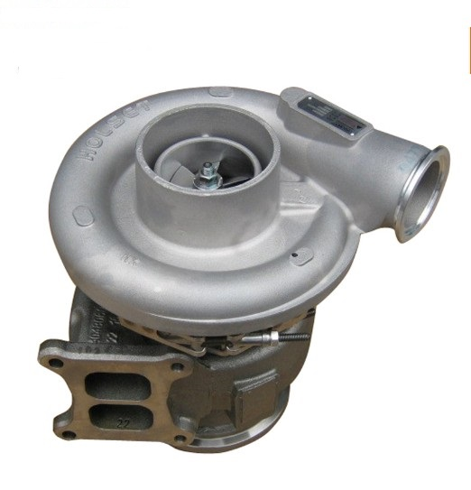
Project Scope
Cummins has an interest in researching and selecting alternate materials to fabricate compressor casings in their B series turbochargers
This alternate material should ultimately be more cost effective than the current one in use, cast aluminum 356, and still satisfy the design and operational parameters set by Cummins
Fig.1: View of turbocharger.[5]
Estimates of manufacturing costs for this alternate material and 3 full scale prototypes are key requirements
Alex Mankin

Slide 4
Project Background
In industry more cost efficient materials are always being researched
Finding new materials which could replace cast aluminum 356 presents many beneficial opportunities for Cummins
The revenue gained from more cost efficient materials and manufacturing processes present financial advantages for Cummins
Production numbers on compressor casings and turbochargers have the potential to grow allowing the company to meet and exceed the expectations of customers
Alex Mankin

Slide 5
Project Objectives
Determine the temperatures, pressures, and stresses experienced by the compressor during operation
Research and compare materials which can operate under these prescribed physical conditions, and are cheaper both as a material and to manufacture
Estimate manufacturing costs with this new material and compare it to cast aluminum 356, which is currently used to fabricate the casings
With the known operational conditions and alternate material known, utilize Finite Element Analysis in conjunction with a CAD model of the casing for analysis
Obtain three prototypes of these casings for testing and experimentation
Ralph Scott

Slide 6
Fall 2013 Accomplishments
PEEK(Polyether ether ether ketone) was selected as the material to be used as the compressor casing after thorough research.
FEA analysis was conducted on a cross section of the casing’s piping to ensure that material selected would not deform significantly during operation.
A contact at Cummins was found who will obtain prototypes based on our chosen alternate material.
Initial research was begun on carrying out FEA analysis for the burst event.
Ralph Scott

Slide 7


Design Concepts
Injection Molding Cost Estimation Equations
The following are equations that can be used to determine manufacturing cost associated with producing a injection molded part.
1.)
2.)
Ralph Scott

Slide 8
Design Concepts
Injection Molding Cost Estimation Equations
The cost drivers of manufacturing injection molded parts are expressed in Equation 1.
1.)
C_{mat} , is the material cost contribution. Generally 50-80% of the total part cost.
C_{proc} , is the cost of processing the part and is dependent on the hourly rate charged for the usage of the injection molding machine.
y_{proc} , the ratio of good parts to the total number of parts produced.
C_{tool} , the tooling cost.
N , the production quantity for the life of the tool.
Ralph Scott

Slide 9
Design Concepts
Injection Molding Cost Estimation Equations
Equation 2 is an expression for the assembled product cost
2.)
m, parts that constitute the product include both injection molded and standard purchased parts.
R_{assy} , assembly shop hourly rate.
C_{OH} , overhead cost per product.
Ralph Scott

Slide 10
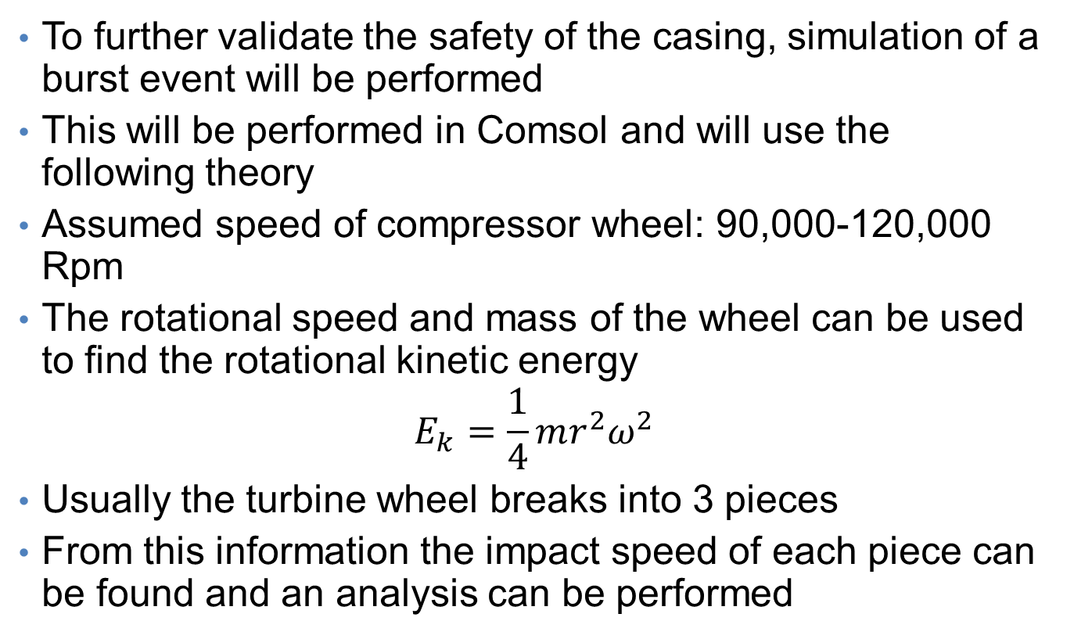
Design Concepts
To further validate the safety of the casing, simulation of a burst event will be performed
This will be performed in Comsol and will use the following theory
Assumed speed of compressor wheel: 90,000-120,000 Rpm
The rotational speed and mass of the wheel can be used to find the rotational kinetic energy
$$E_{k}=\frac{1}{4}mr^{2}ω^{2}$$
Usually the turbine wheel breaks into 3 pieces
From this information the impact speed of each piece can be found and an analysis can be performed
Alex Mankin

Slide 11
Potential Challenges and Risks
Making sure the assumptions and cost estimations made during the manufacturing cost analysis are accurate, and comparable to real world applications.
Ensuring that our analysis on our 3-D model of the compressor casing, is an accurate representation of the effects the compressor casing would undergo in the field.
To be able to run a burst containment test on our full scale compressor casing prototype in a safe manner.
Ralph Scott

Slide 12
Status of procurement
The prototype based on PEEK could not be machined because it could not be procured in a large enough block.
A proprietary powder material will instead be used to 3-D print a compressor casing prototype for demonstration purposes only.
A comparison will be performed between the theoretical functional PEEK based casing and the proprietary material through the use of FEA analysis
Ralph Scott

Slide 13
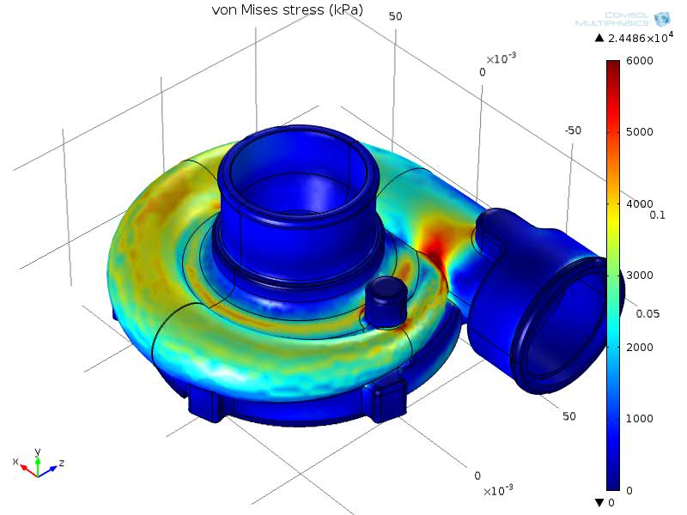
Casing Analysis
Alex Mankin

Slide 14
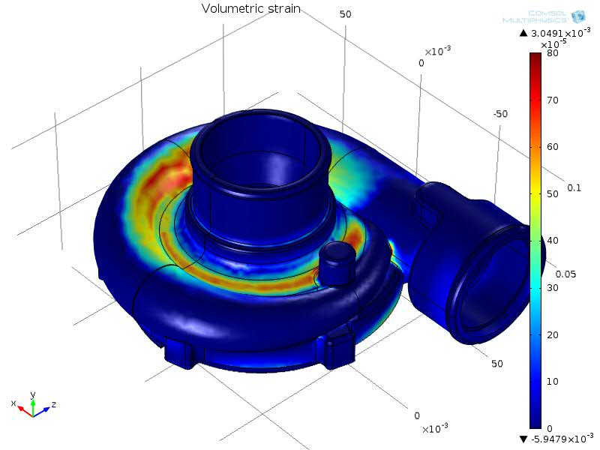
Casing Analysis
Alex Mankin

Slide 15
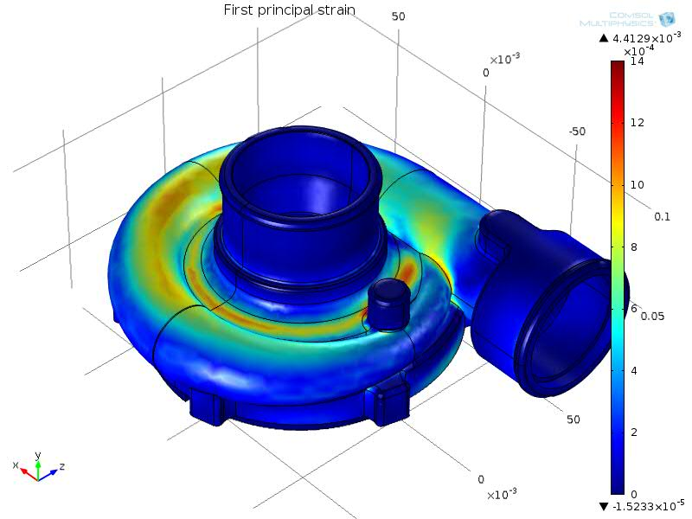
Casing Analysis
Alex Mankin

Slide 16
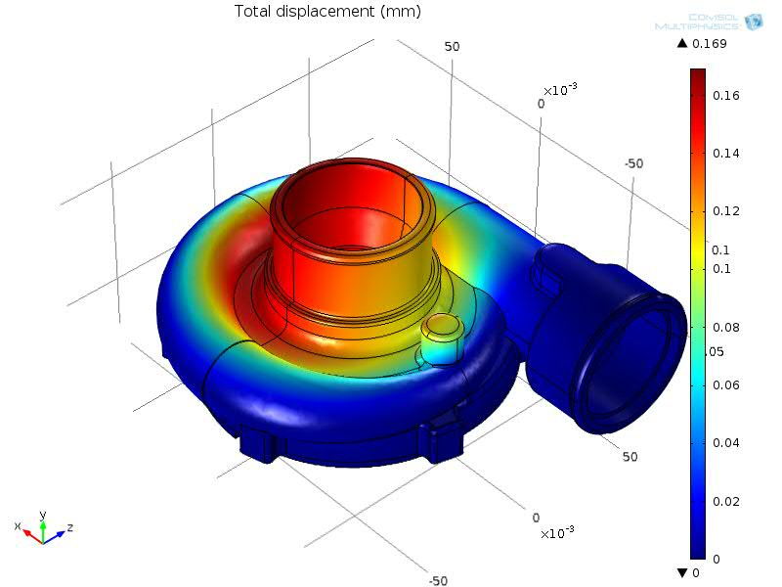
Casing Analysis
Alex Mankin

Slide 17
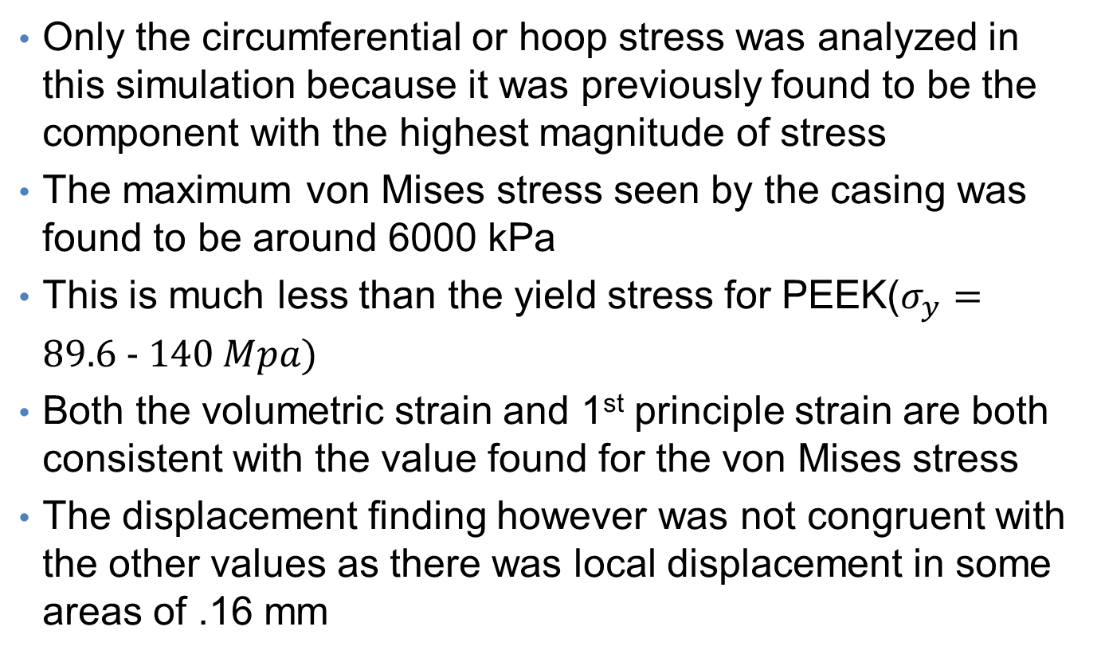
Summary of Casing Analysis
Only the circumferential or hoop stress was analyzed in this simulation because it was previously found to be the component with the highest magnitude of stress
The maximum von Mises stress seen by the casing was found to be around 6000 kPa
This is much less than the yield stress for PEEK($σ_{y}=89.6 − 140 Mpa$)
Both the volumetric strain and 1st principle strain are both consistent with the value found for the von Mises stress
The displacement finding however was not congruent with the other values as there was local displacement in some areas of .16 mm
Alex Mankin

Slide 18
Future Work Plans
The future plans includes the following:
Calculating and estimating the manufacturing costs using the equations and parameters that was given in the previous slides
Also in other to have accurate cost evaluations some faculty members will be consulted ( Dr. Chad Zeng and Dr. Chengying Xu )
Abiodun Oluwaluwo

Slide 19
Future Work Plans Continued
Comsol will be used to carry out the burst containment test in order to check the effectiveness of the material selected for the prototype
Once the proprietary material properties are obtained, analysis will performed again to determine the material’s possibility of use
Also, if time permits ,the actual event will be carried out on our prototype
Abiodun Oluwaluwo

Slide 20
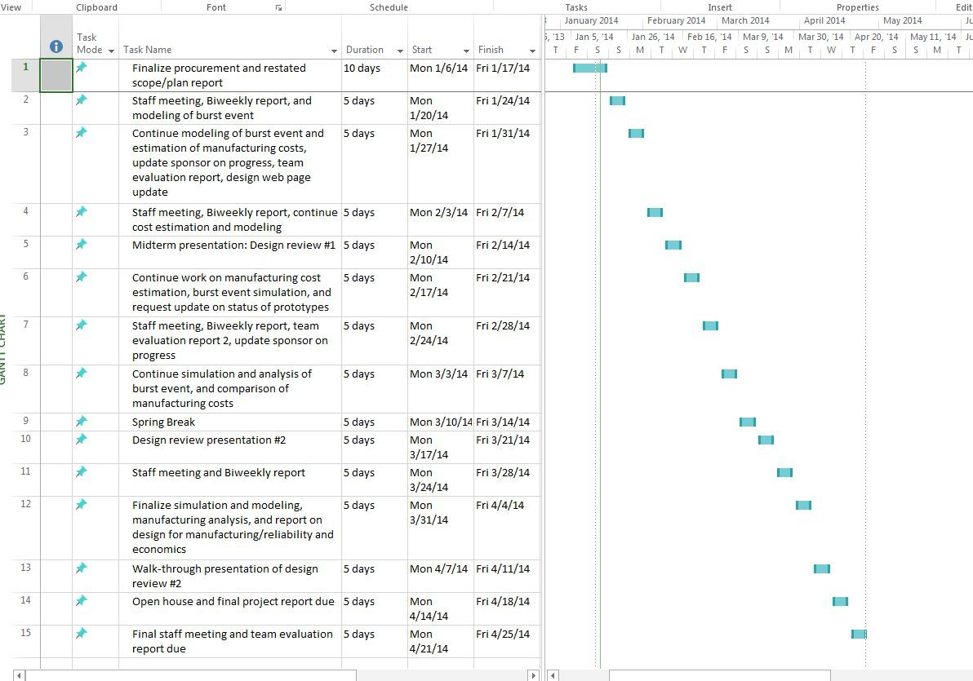
Gantt Chart
Abiodun Oluwaluwo

Slide 21
Conclusions
We are going to continue working with Comsol by performing simulated burst containment tests on both our chosen material PEEK, and the 3D printed material used to create our prototype.
With guidance from the aforementioned faculty advisors, coupled with continued research into manufacturing costs.
We will continue to refine our manufacturing cost analysis.
A full scale 3D printed model of the turbo charger compressor casing is planning on being made instead of our chosen material, PEEK.
Abiodun Oluwaluwo

Slide 22
References
1. "Turbo Torque." Turbo Torque. N.p., n.d. Web. 21 Oct. 2013. <http://www.mazdarotary.net/turbo.htm>.
2. "Online Materials Information Resource - MatWeb." Online Materials Information Resource - MatWeb. N.p., n.d. Web. 21 Oct. 2013. <http://www.matweb.com/>.
3. "Plastic Sheet, Plastic Rod, Plastic Tubing - Buy Online." Plastic Sheet, Plastic Rod, Plastic Tubing - Buy Online. N.p., n.d. Web. 21 Oct. 2013. <http://www.professionalplastics.com/>.
4. "VICTREX® PEEK Polymers." High Performance Polyaryletherketones, High Temperature Advanced PEEK Polymer, Thermoplastic. N.p., n.d. Web. 19 Nov. 2013. <http://www.victrex.com/en/products/victrex-peek-polymers/victrex-peek-polymers.php>.
5. "Burst and Containment: Ensuring Turbocharger Safety." Turbobygarrett.com. N.p., n.d. Web. 19 Nov. 2013. <http://www.turbobygarrett.com/turbobygarrett/sites/default/files/Garrett_White_Paper_02_Burst__Containment.pdf>.
6. Fagade, Adekunle A., and David O. Kazmer. "EARLY COST ESTIMATION FOR INJECTION MOLDED PARTS." University of Massachusetts Amherst (n.d.): n. pag. Web.

Slide 23
Questions

